Slide 1
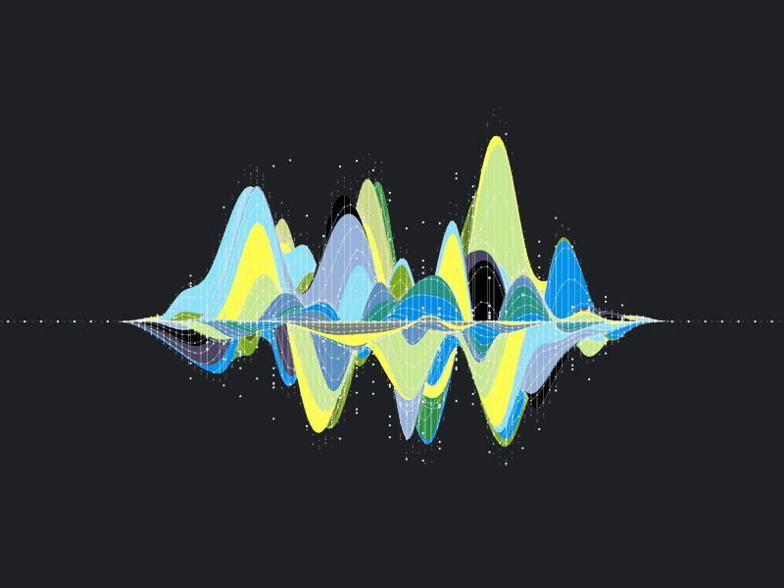

Citi Bike Trip Analysis January 2019 to July 2019
Joshua Marcus, Darren Pardo, Henry Sanchez, Jakub Tamulewicz

Slide 2
Project Overview
Our employer, Citi Bike, tasked our team with building a trip duration prediction tool for the marketing department
The primary function of this tool is to use inputs such as user gender, age, subscription type and trip start time to predict a total trip time
Our team decided to use pandas to clean the data and matplotlib to visualize it
We decided to visualize additional data in JavaScript, html/CSS, and tableau
After attaining a better understanding of all of the data, our team decided to create a linear regression machine learning model to predict trip time

Slide 3
Data Cleaning (Source)
Data Source: Citi Bike Trip Data Jan. 2019 to Jul. 2019
Info recorded for every trip including details such as:
Gender of Rider
Age of Rider
Start and End Location
Trip Duration
https://s3.amazonaws.com/tripdata/index.html

Slide 4
Data Cleaning (Jupyter Lab)
Combining monthly trip data with concatenation function into one CSV
Using pandas to extract columns from CSV and generate dataframe
Filter for relevant data using pandas select function
Convert birth year into age and extract month, weekday, and day of the month
tripduration | starttime | stoptime | start station id | start station name | start station latitude | start station longitude | end station id | end station name | end station latitude | end station longitude | bikeid | usertype | birth year | gender
tripduration | starttime | start station latitude | start station longitude | usertype | birth year | gender
tripduration | starttime | start station latitude | start station longitude | usertype | gender | age | starttime - Day | starttime - Month | starttime - Time | starttime - Weekday

Slide 5
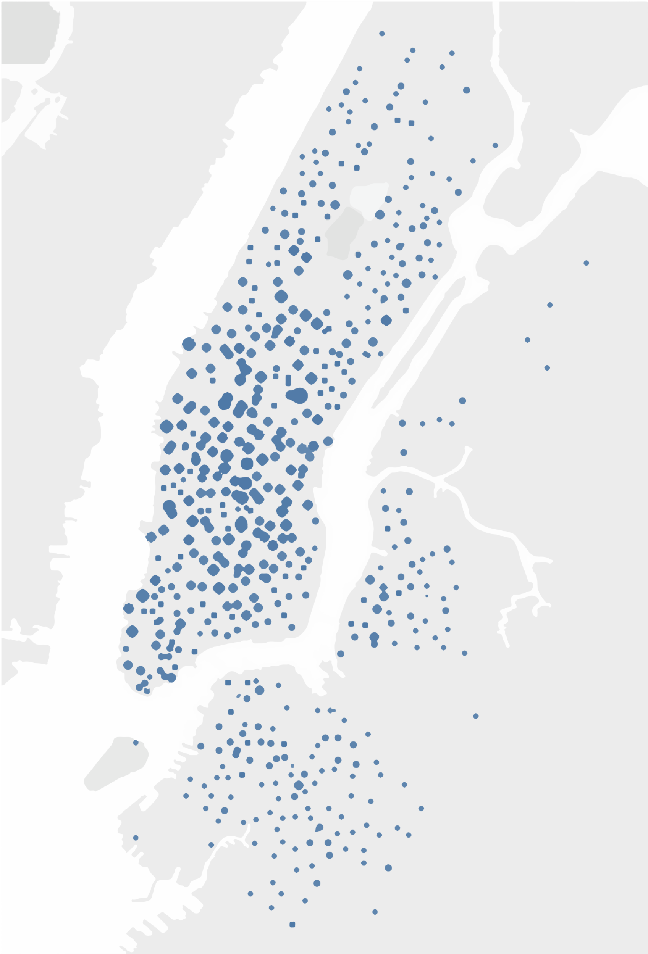
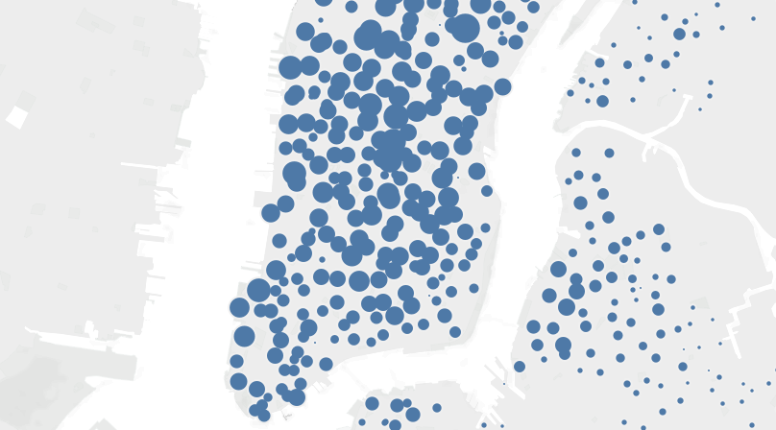
Map Overview
Starting locations by popularity
Majority of traffic is in midtown
Midtown
NYC

Slide 6
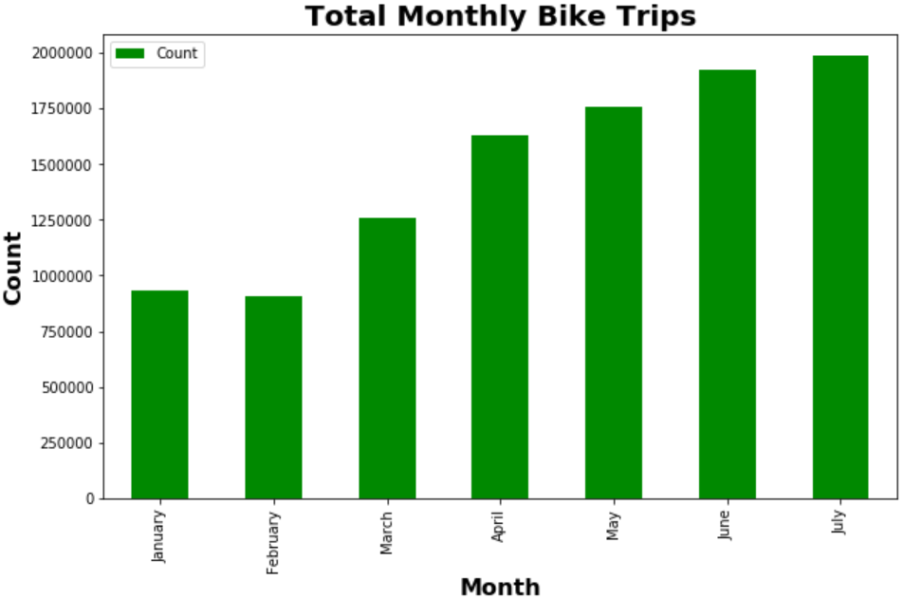
Total Trip Breakdown By Month
Predictably, trips go up as climate gets warmer
Lowest being February at 90,653
Highest being July at 1,984,131
Month | Month Total
January | 932399
February | 906543
March | 1255727
April | 1627160
May | 1755609
June | 1925894
July | 1984131

Slide 7
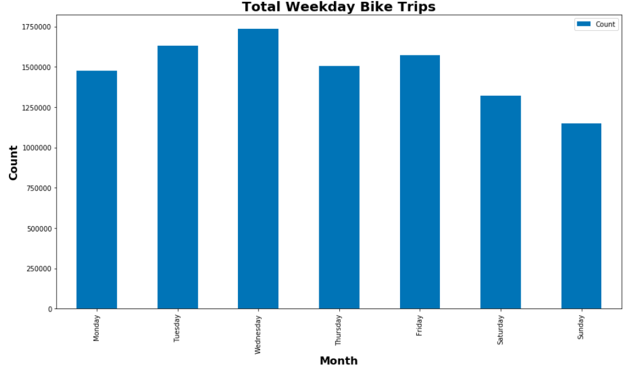
Total Trip Breakdown by Weekday
Trips trend up in the middle of the work week, and trends down towards the weekend
Lowest being Sunday at 1,150,419
Highest being Wednesday at 1,734,967
Weekday | Weekday Total
Monday | 1475751
Tuesday | 1632543
Wednesday | 1734967
Thursday | 1504629
Friday | 1570145
Saturday | 1319009
Sunday | 1150419

Slide 8
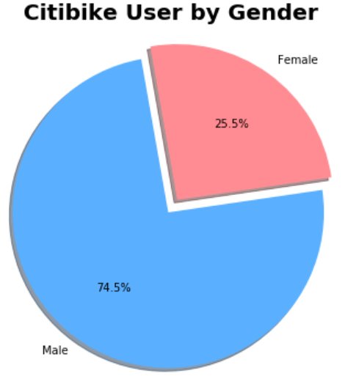
Breakdown of User Total by Gender
The majority of trips over the 7 months were taken by Males at %75
Note that gender data is user-reported
Gender | Total
Male | 7741743
Female | 2645720

Slide 9
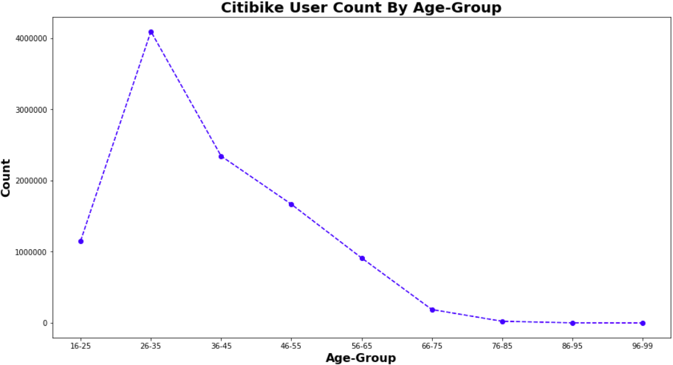
Breakdown by Age Group
The majority of Citi Bike users are between the ages of 26 and 35
Note ages are also user-reported
Age | Count
16-25 | 1154191
26-35 | 4094558
36-45 | 2344004
46-55 | 1667063
56-65 | 913139
66-75 | 188625
76-85 | 23784
86-95 | 1892
96-99 | 207

Slide 10
Machine Learning
Using all of our data on each trip, we created a model to predict trip duration
The type of model we chose was a stochastic gradient descent regressor, as this is model is best suited for large data sets (exceeding 100k points)
Due to the complexity and randomness of the data set, we were only able to achieve an R factor of about -0.032
Other models have shown up to a 0.77 R factor, but these used the end location, which we thought to be disingenuous for our project

Slide 11
Web Interface Design for Employees
The last goal of our project was to design a straight-forward user interface for inputting data into the model
This will enable to the Citi Bike marketing department with a more effective means of presenting the model to non-technical clients
We have provided various graphical data to give anyone looking into the model a better understanding of its complexity

Slide 12
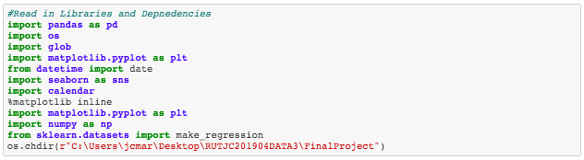

Slide 13
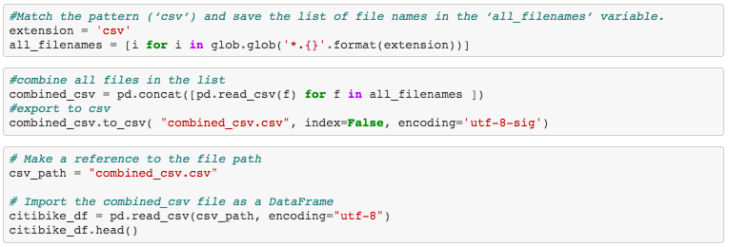

Slide 14
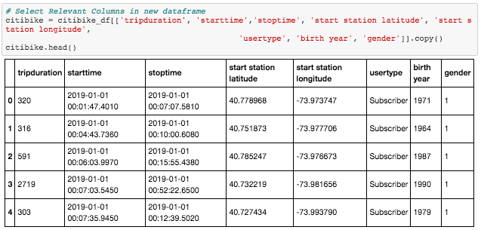

Slide 15
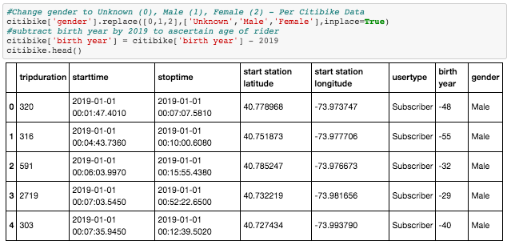

Slide 16
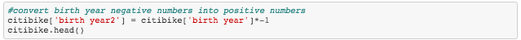
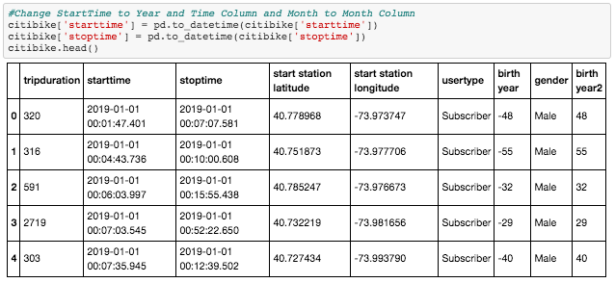

Slide 17
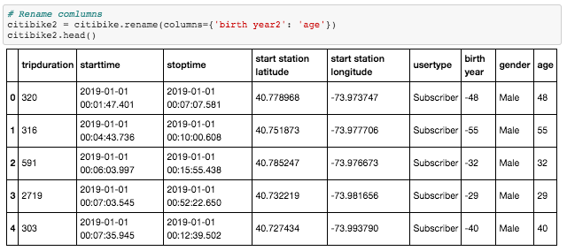

Slide 18
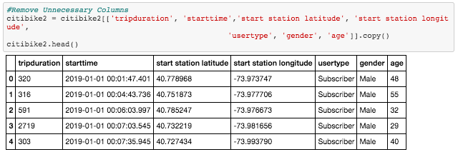

Slide 19
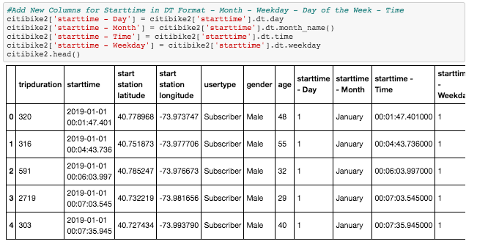

Slide 20
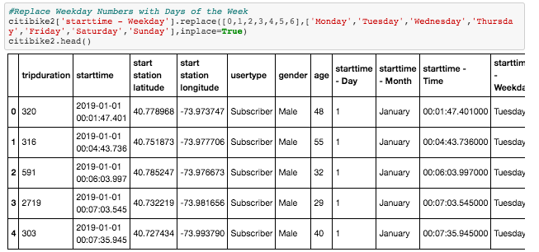

Slide 21
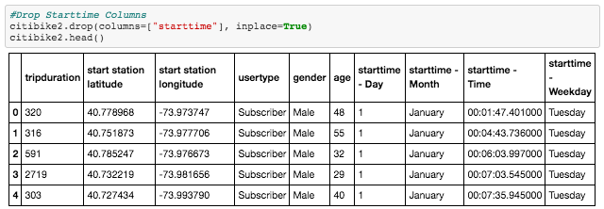

Slide 22
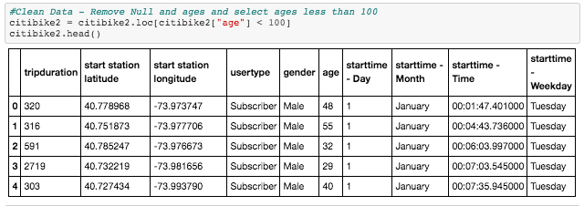

Slide 23
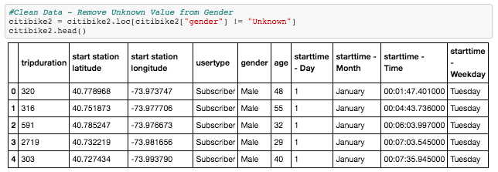

Slide 24
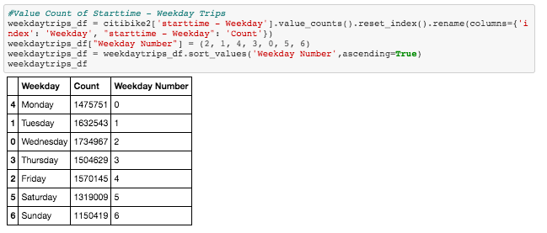

Slide 25
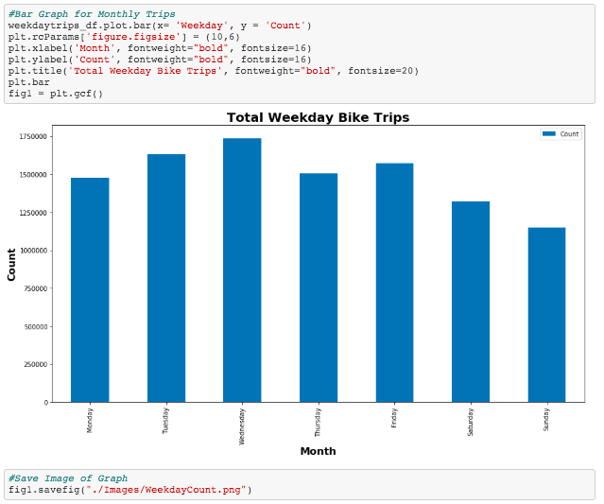

Slide 26
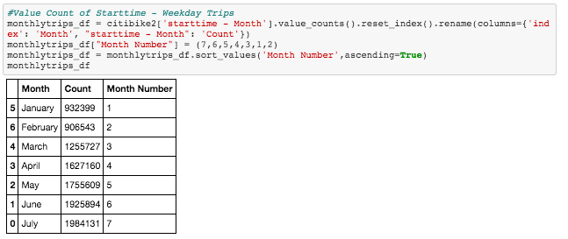

Slide 27
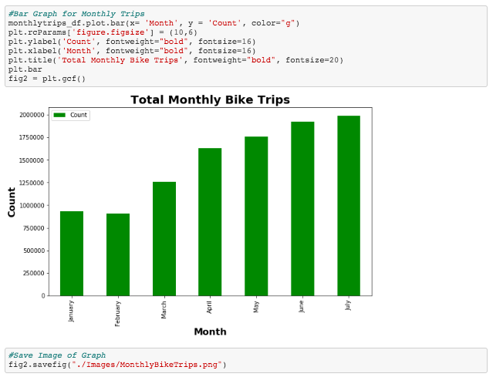

Slide 28
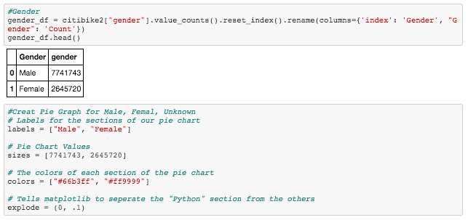

Slide 29
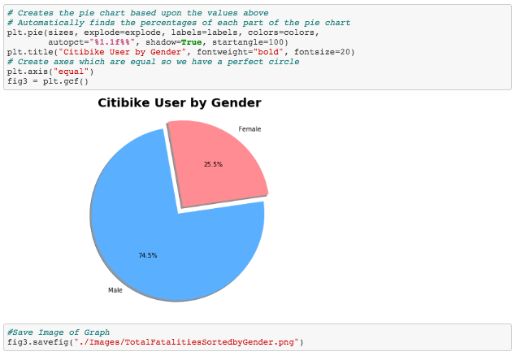

Slide 30
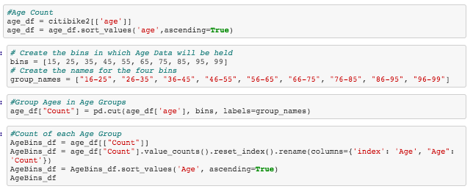

Slide 31
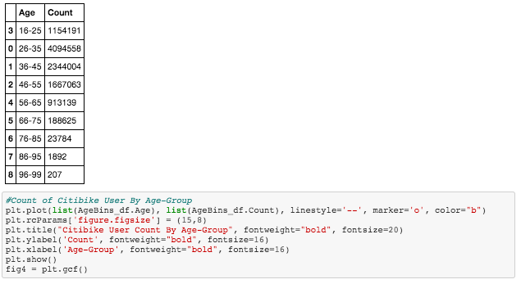

Slide 32
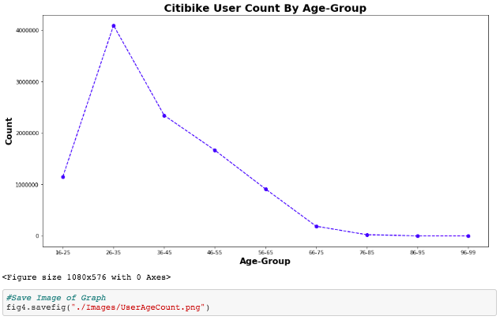

Slide 33
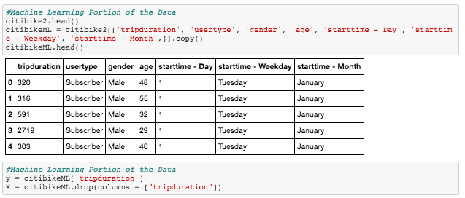

Slide 34
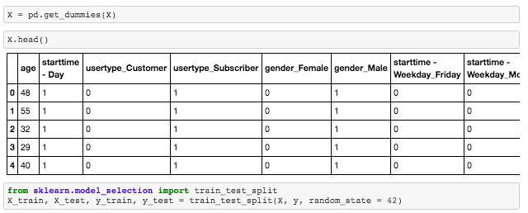

Slide 35
